Slide 1
CS 6233
Operating Systems
Professor K. Yotov
Some slides adapted by G. Sandoval and K. Yotov for CS6233
from Tanenbaum & Bo, Modern Operating Systems:4th ed., (c) 2013 Prentice-Hall, Inc. All rights reserved.
Also from Slides by Brendan Dolan-Gavitt

Slide 2
About me
Grew up in Bulgaria
Spent significant time on Competitive Coding (IOI, ACM, TopCoder)
PhD in Computer Science (Compilers, Cornell University)
2 Internships in Microsoft and a Post-Doc in IBM
6 years Software Engineer, Core Strategies, VP, Goldman Sachs
6.5 years at Two Sigma Investments
2 years Software Engineer (VP), High Frequency Trading Developer
3.5 years Manager of Trading Platform Engineering (VP)
1.5 years Manager of Software Development Life Cycle (SVP)
Adjunct at NYU starting Fall 2017

Slide 3
administrivia

Slide 4
Meeting Times
Course meets Wednesday, 6:00 pm – 8:30 pm
370 Jay Street, Room 202
(hopefully the room you’re in right now)

Slide 5
Syllabus
Review now and it’s in NYU Classes

Slide 6
Homework
Homework will consist entirely of programming projects
Each project may be done with one other person
When you submit, include the name of your partner
Only one person in a pair needs to submit each assignment
If both of you submit, we'll pick one arbitrarily and grade it (so if they're different, we won't know)
At the end of the semester, there will be an optional bonus assignment that you can use to replace your lowest homework grade

Slide 7
Homework
Homework assignments must be submitted to me by midnight on the day they are due
Late assignments will not be graded, and you will get a 0 for the assignment
Make sure your code compiles – non-compiling code will not be graded.

Slide 8
Office Hours
Working out the logistics… until then by appointment
Email me and we can set up time to meet
TAs will also hold office hours (TBA)

Slide 9
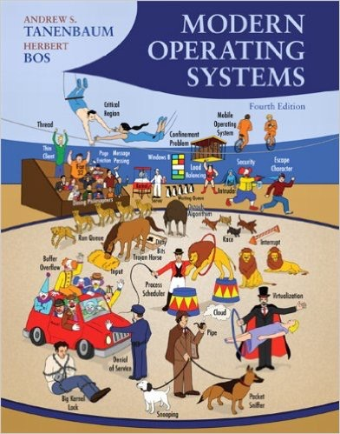
Textbook 1
We will be using Modern Operating Systems, by Andrew S. Tanenbaum
This should be available at the NYU bookstore
Ebook/PDF and international editions of the book are also fine

Slide 10
Textbook 2
Throughout the semester we will be studying the source code of a UNIX-like operating system, xv6
The authors of xv6 have written a short (100 page) book about its implementation, which accompanies the source code
This has been posted on NYU Classes in the Resources section

Slide 11
Programming Language
The homework will require you to write code in C
If you have worked with C++; C is in most respects a subset of C++
However, you may find that you need to understand the language in greater depth than you have before
We will review C
If you have never programmed or never coded in C you will have trouble with this class

Slide 12
Development Environment
Many of the programming assignments will involve modifying the xv6 OS to add new features or change how it works
You will need to use a UNIX-like operating system (Linux or OS X) to build and run the xv6 OS
We will run the xv6 operating system inside a PC emulator called QEMU, which will also need to be installed

Slide 13
Development Environment
Tools :
The gcc compiler
The gdb debugger
The GNU binutils
QEMU, a PC emulator

Slide 14
Development Environment
We have a virtual machine image with Linux installed that you can use. Mandatory if you use Windows, recommended if you use Mac
The virtual machine can be imported into VirtualBox (free) and VMWare (faster, but costs money)
On OS X, you can install all the tools you need without having to use a virtual machine
Installation is slightly tricky, some instructions available: http://laredo-13.mit.edu/~brendan/cs3224/install.html

Slide 15
Operating systems today

Slide 16


Slide 17
(quick) Computer history

Slide 18
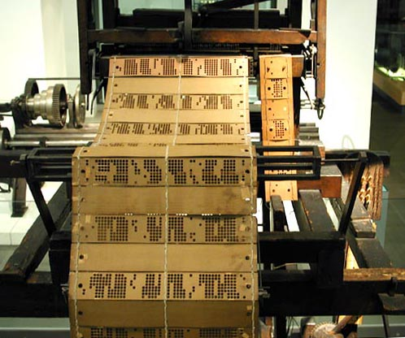
Pre-Pre-History
The Jacquard Loom.
Invented by Joseph Jacquard in 1801
Used punched cards to describe patterns to weave
We’ll see such cards again…

Slide 19
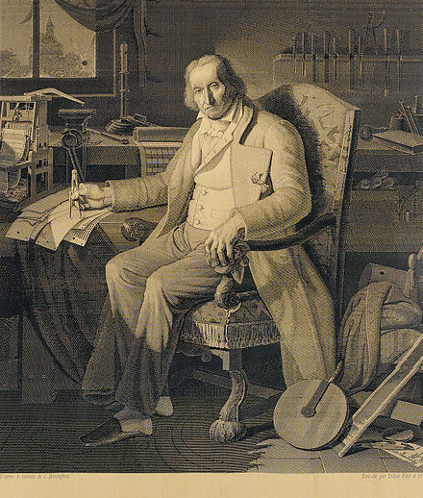
Pre-Pre-History
Jacquard Loom could even be used to weave portraits
This one took 24,000 punch cards to specify
A picture is worth 1,000 words, or 24,000 punch cards

Slide 20
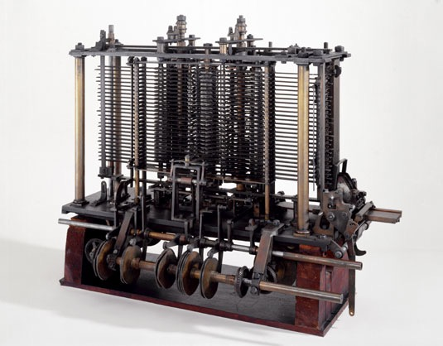
Pre-History
The Analytical Engine: designed by Charles Babbage. (1837)
Intended to be able to carry out arbitrary computations
Never completed (lack of funding)
Contained:
Arithmetic unit
Conditional Branching
Loops
First “Turing Complete”

Slide 21
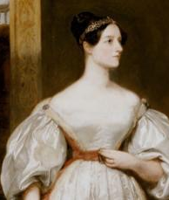
Prehistoric Programming
Ada Lovelace (1815-1852) worked with Babbage to create programs for the Analytical Engine
Created an algorithm to compute Bernoulli numbers on the machine
First Programmer and also the first programmer to stay up all night working on code!

Slide 22
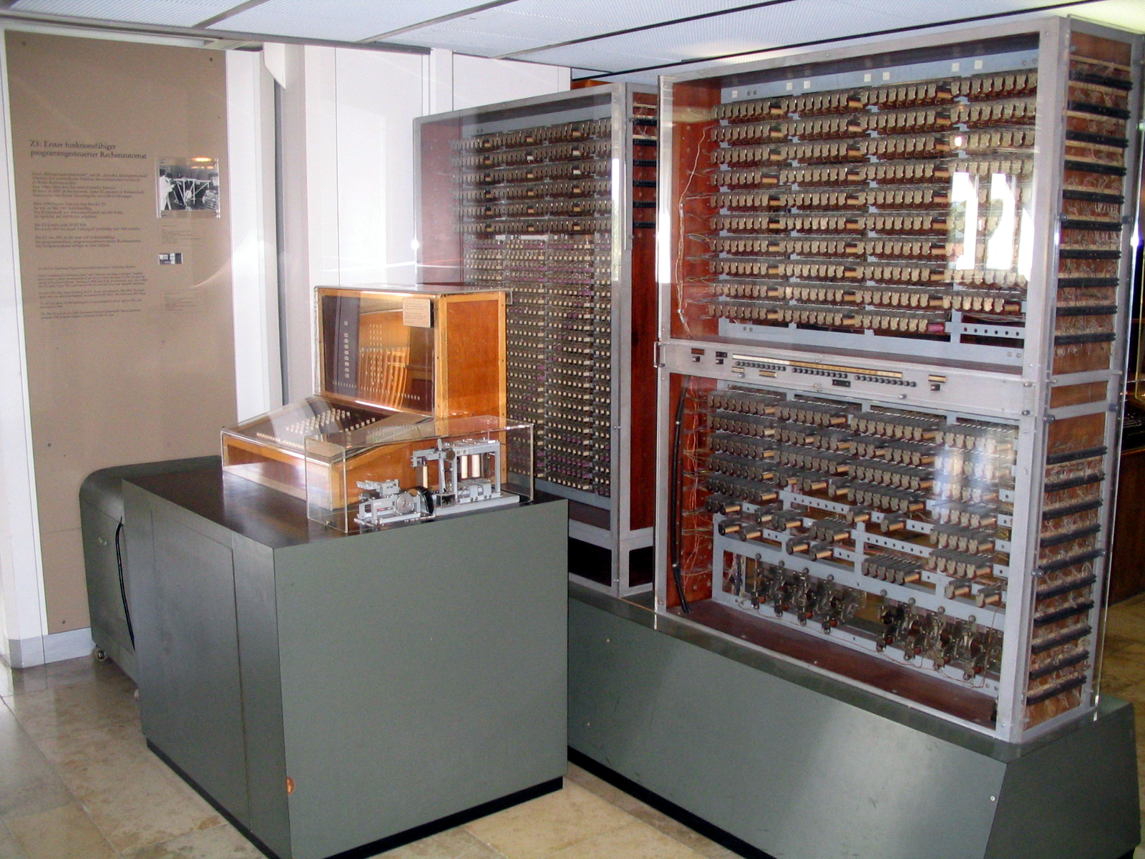
Z3 Machine (1941)
Electromechanical relay computer built in Germany by Konrad Zuse
Technically Turing-complete (proved in 1998), but typically just carried out specific calculations
Photo by Wikipedia User Jahoe

Slide 23
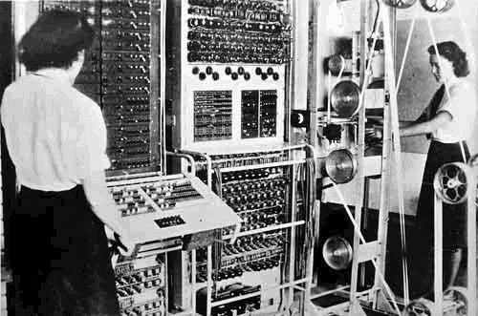
Colossus (1943)
Designed by Tommy Flowers at Bletchley Park (England) for use in decrypting German radio teleprinter messages (not Enigma)
One of the programmers was Alan Turing

Slide 24
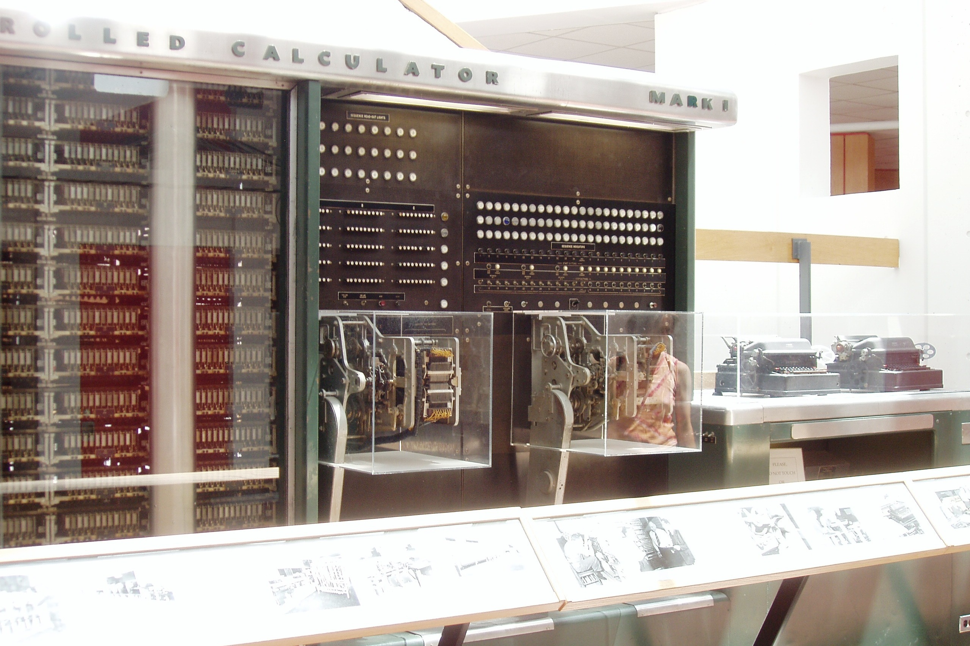
Harvard Mark I (1944)
Used for atomic bomb computations in Manhattan Project
Program “loops” by physically connecting the end of the program tape to the start, forming a loop
One of it’s first programmers was Grace Hopper
Photo by Wikipedia User Topory

Slide 25
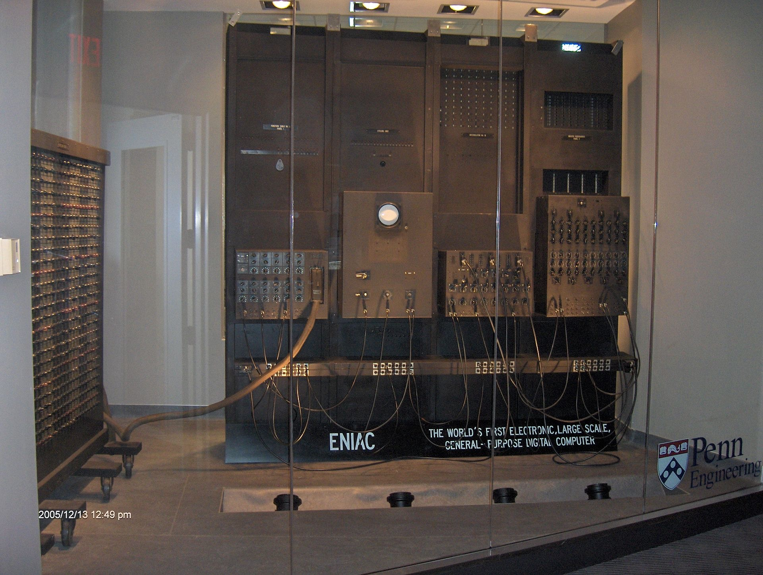
ENIAC (1946)
Built at U Penn; used for artillery and hydrogen bomb computations
Photo by Wikipedia User TexasDex

Slide 26
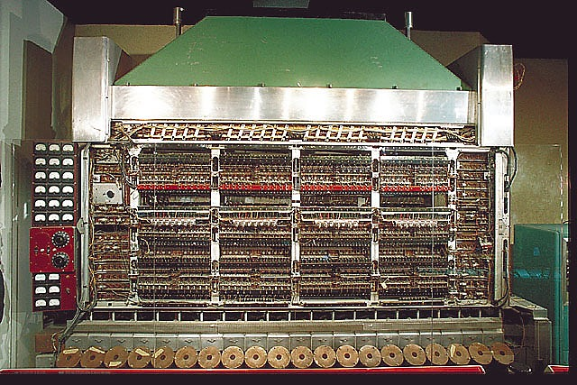
Institute for adanced study (IAS) Machine (1951)
One of the earliest to store code and data in the same memory
Origin of the term “von Neumann Bottleneck”

Slide 27
Early Computing History
Early machines were programmed directly in machine language (or even direct wiring!)
No C, Java, Python, etc.
Not even any assembly language

Slide 28
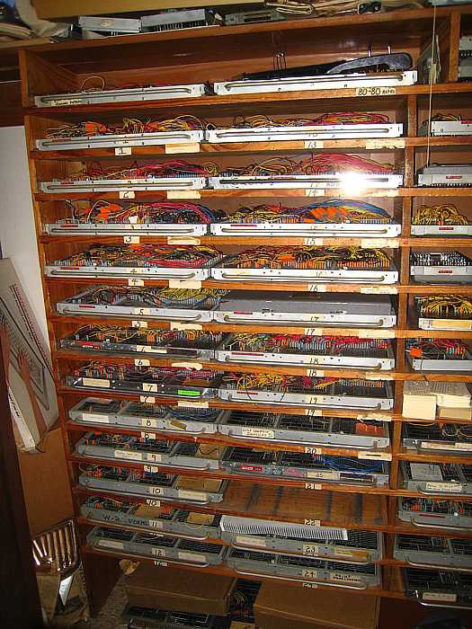
“Programs” on the IBM 402
Each program is actually a plugboard wired up to configure the machine
This picture is from a company called Sparkler Filters, which still uses its IBM 402 from 1948

Slide 29
History of Operating Systems
The first generation (1945–55) vacuum tubes
The second generation (1955–65) transistors and batch systems
The third generation (1965–1980) ICs and multiprogramming
The fourth generation (1980–present) personal computers
The fifth generation (1990–present) mobile computers

Slide 30
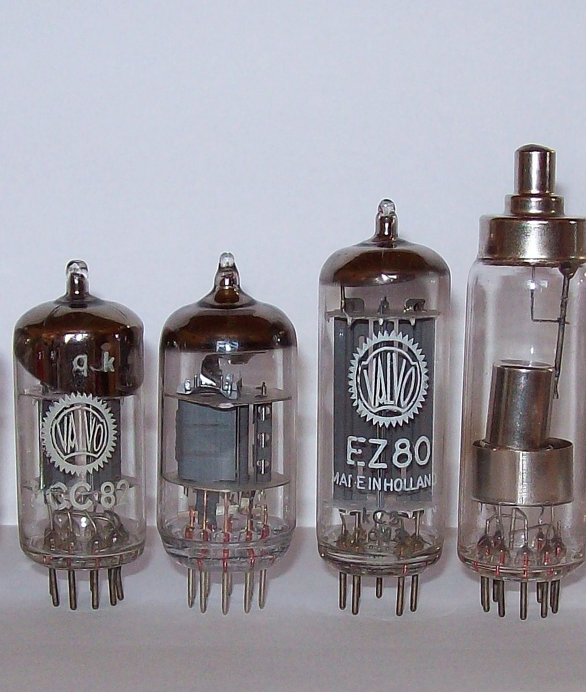
1. Vacuum Tube Technology
Vacuum tubes functioned as high-speed electronic switches
Access times for these machines are around 100 milliseconds (1/10 of a second)

Slide 31
2. Transistor & Batch (1955-1965)
Transistors allowed computers to be reliable enough for commercialization
Mainframes
Only government & Universities
Computing time was typically metered
Being able to fully use the CPU for the time you were allotted was very important!
Transistor-based machines were also much faster
Access times around 100µs – that’s micro seconds
This is a speedup of ~1000x!

Slide 32
Batch Jobs
An individual job took the form of a set of punch cards
Cards were loaded onto magnetic tape (using a fast reader), carried over to the actual computer, and then the output tape was brought over to a printer
The key idea of batch processing is to collect multiple jobs which can be loaded onto the tape and then processed all at once

Slide 33
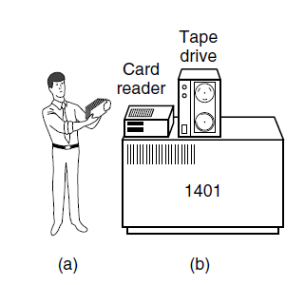
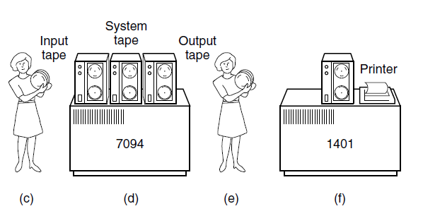
Batch jobs

Slide 34
3. Ics and multiprogramming (1965 – 1980)
Integrated Circuits that contain many transistors
Consolidated both the cheap and expensive machines
IBM system/360 first one to use Integrated Circuits
Multiprogramming
Timesharing
Started here MULTICS -> UNIX (FreeBSD, Linux, iOS, Android)
Tanenbaum & Bo, Modern Operating Systems:4th ed., (c) 2013 Prentice-Hall, Inc. All rights reserved.

Slide 35
4. Personal computers (1980 – Present)
Large Scale Integration Circuits (Chips) containing 1000s of transistor in a sq centimeter
IBM 8080
Microsoft DOS, Windows
Apple

Slide 36
5. Mobile computers (1990 – Present)
Nokia N9000/Symbian
Blackberry
Windows Phone
iPhone/ iOS
Android

Slide 38
The Operating System Zoo
Mainframe Operating Systems
Server Operating Systems
Multiprocessor Operating Systems
Personal Computer Operating Systems
Handheld (Mobile) Computer Operating Systems
Embedded Operating Systems
Sensor Node Operating Systems
Real-Time Operating Systems
Smart Card Operating Systems
Notes:
Mainframe: found in major data centers. Huge I/O capacity. Bank/Airline
Server: server multiple users at once: file service/web service: Used by Internet Providers. Examples Linux, Windows Server 201x
Multiprocessor: Multiple cores in a single system. You probably have one. Windows/Linux/ Osx
Personal: Windows, Linux. The intersection with Multiprocess is pretty high
Handheld: Android and iOS
Embedded: TVs, Cars, ChromeCast, AppleTV, etc.
Sensors: deployed in buildings, borders, citties. Each one is a CPU with RAM/ROM
Real-Time: Industrial processes. Must provide absolute guarantee that a certain action will occur
Smart Card: huge processing power and memory constraints. Single Function: electronic payments.

Slide 39
What is an Operating system ?

Slide 40
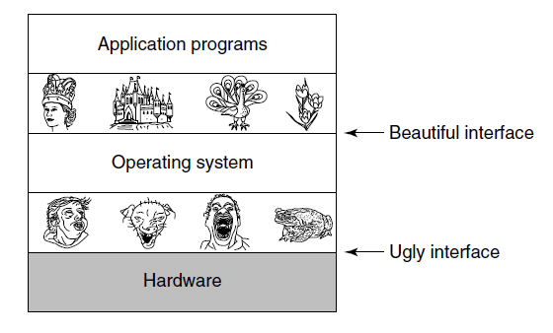
The Operating System as an Extended Machine
Operating systems turn ugly hardware into beautiful abstractions.

Slide 41
The Operating System as a Resource Manager
Top down view
Provide abstractions to application programs
Bottom up view
Manage pieces of complex system
Alternative view
Provide orderly, controlled allocation of resources

Slide 42
Hardware overview

Slide 43
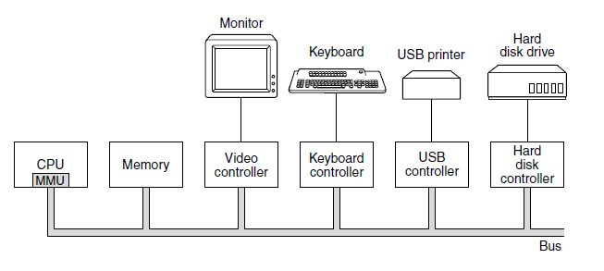
Components of a very simple personal computer.

Slide 44
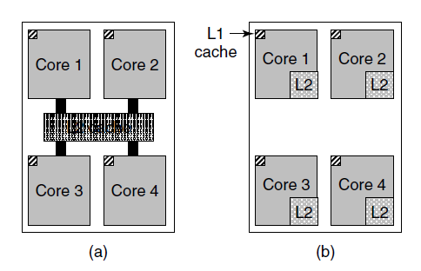
Processor (CPU)
Figure 1-8. (a) A quad-core chip with a shared L2 cache. (b) A quad-core chip with separate L2 caches.
Notes:
Note the share L2 cache vs separate L2 Cache

Slide 45
Memory
Ideally should be extremely fast, large and cheap.
Not possible so tradeoffs: Caching
Cache: Types:
L1 Cache – Inside the CPU
L2 Cache
RAM
ROM
EEPROM (Flash)
Disks

Slide 46
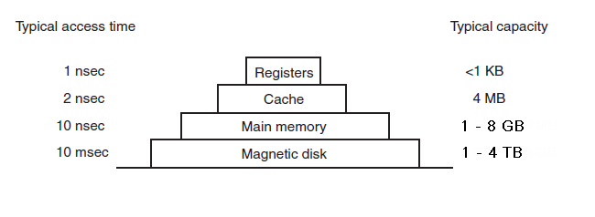
Memory
A typical memory hierarchy. The numbers are very rough approximations.
Notes:
Nanosecond = billionth of a second
Microsecond =

Slide 47
Grace Hopper
American Computer Scientist and Navy Rear Admiral
One of the first programmers of the Mark 1
Invented the first compiler
Popularized the idea of machine independent programming languages.
She will explain better than I could the difference between a nanosecond and a microsecond: https://www.youtube.com/watch?v=JEpsKnWZrJ8

Slide 48
I/O Devices

Slide 49
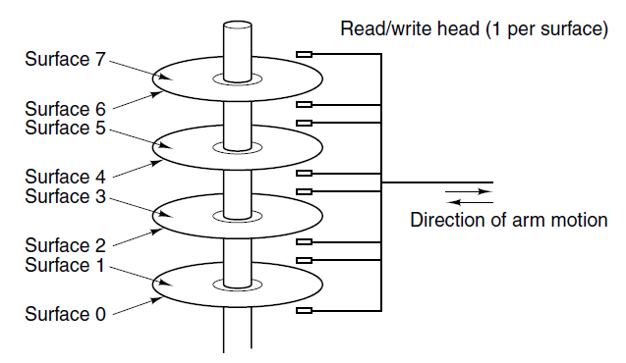
I/O Devices
Two parts:
Controller (Driver)
Device
Controller abstracts the hard interface to the OS
Example:
OS -> Controller: Read Sector 11,206
Controller -> Device:
Converts to Cylinder, Sector and Head
Move from current cylinder to new one
Move to new sector
Read/write
All this done asynchronously through interrupts
Notes:
Controller.
Waits for the proper sector to rotate under the head and start reading/writing

Slide 50
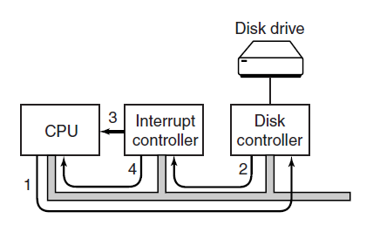
I/O Devices
Steps in starting an I/O device and getting an interrupt.

Slide 51
Buses in the original IBM PC
Notes:
In the original IBM PC

Slide 52
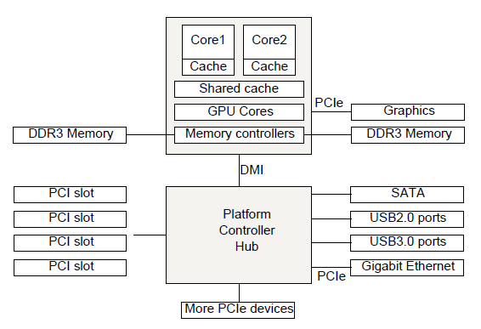
Buses NOw
Structure of a large x86 system
Notes:
Different Buses each with a higher throughput per use:
Cache
Memory
PCIe
PCI
USB
SATA

Slide 53
Operating system concepts

Slide 54
Processes
Key concept in all operating systems
Definition: a program in execution
Process is associated with an address space
Also associated with set of resources
Process can be thought of as a container
Holds all information needed to run program

Slide 55
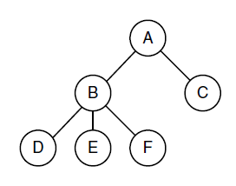
Processes
A process tree. Process A created two child processes, B and C. Process B created three child processes, D, E, and F.

Slide 56
Address spaces
Every process has to use memory to work
In modern OS many programs run concurrently
OS needs to manage this
Virtual Memory is the solution and it’s managed by the OS

Slide 57
files
The OS provides abstractions (system calls) to create, update, delete files.
The OS also provides system calls to create/update/delete directories (folders)
Directory entries might be files or other directories.
Another use is for Interprocess Communication (IPC) using pseudofiles called pipes
Notes:
This abstracts away all the issues with sectors, spindles, heads, etc.

Slide 58
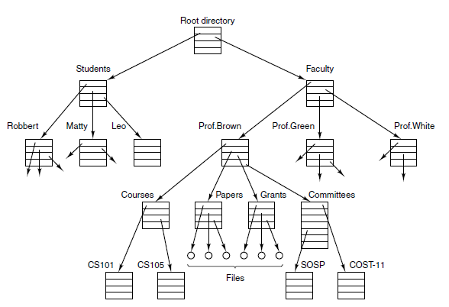
Files
A file system for a university department.

Slide 59
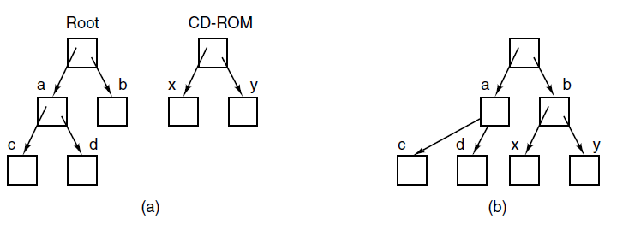
Files with external storage
Before mounting, the files on the CD-ROM are not accessible.
After mounting, they are part of the file hierarchy.

Slide 60
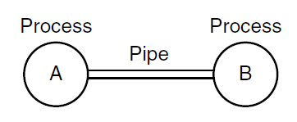
Files
Two processes connected by a pipe.

Slide 61
Input/output
The Operating system also provides abstractions for managing I/O.
For example:
Keyboards
Monitors
Printers

Slide 62
protection
Computers need to keep information secure
It’s the OS job to do this.
Examples:
RWX bits
Password
Fingerprint sensor
Protect from virus

Slide 63
The shell
Not quite part of the OS
In most OS you can have your own shell.
It’s the way in which you interact with the OS unless you use the GUI.
In UNIX there are a few: sh, csh, ksh and bash
You will need to learn it and love it in this class. You might even build your own.

Slide 64
Shell demo
Launch your shell
Type the following commands:
pwd
mkdir test
cd test
pwd
cal
cal > date.txt
cal

Slide 65
System calls
Abstractions that OS provides to interact with it.
Are usually machine dependent
Written in assembly code
Library procedures are used in C/C++.
Let’s trace the read system call:
count = read(fd, buffer, nbytes)

Slide 66
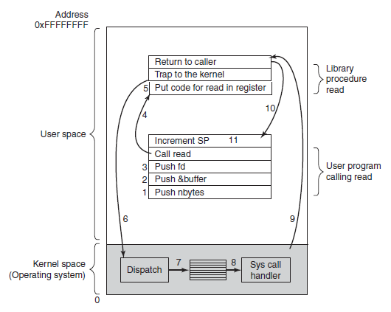
System Calls
The 11 steps in making the system call read(fd, buffer, nbytes).
Notes:
1 -3 Push parameters in the stack. 1 & 3 by value. 2 by reference (remember pointers) ?
5 The library procedure probly written in assembly puts the system call number in a place where OS expects is Register 5
6 Trap to switch from user to kernel mode
TRAP is similar to the procedule-call but also different in that it switches from user/kernel mode
7 The kernel dispatches via a table to the appropirate call
8. System call handler runs
9. Once it completes its job, control is returned to user space
10 returns to the user program
11 cleans up stack

